Slide 1
Model Matching Results
J. Vranciar
3/27/25

Slide 2
Parameters for each trial
Index | frequency | fin_width | muk | kp_ang | kd_ang | mus | epsilon_v
1 | 0.5 | 0.00 | 0.00 | 86.93 | 10.00 | 1.02 | 0.0000407
2 | 0.5 | 0.00 | 0.00 | 70.00 | 10.00 | 0.00 | 0.0005618
3 | 0.5 | 0.00 | 0.00 | 90.00 | 10.00 | 0.00 | 0.0000100
16 | 0.5 | 0.00 | 0.00 | 90.00 | 10.00 | 0.00 | 0.0000100
17 | 1 | 2.00 | 1.30 | 70.00 | 10.00 | 0.00 | 0.0008349
4 | 1.25 | 2.00 | 0.62 | 70.00 | 10.00 | 0.00 | 0.0010000
5 | 1.25 | 1.92 | 0.00 | 90.00 | 4.68 | 2.95 | 0.0000100
6 | 1.25 | 2.00 | 0.26 | 70.02 | 10.00 | 0.00 | 0.0002041
7 | 1.5 | 2.00 | 0.35 | 70.00 | 10.00 | 0.00 | 0.0003935
8 | 1.5 | 2.00 | 0.01 | 70.00 | 10.00 | 0.00 | 0.0009969
10 | 1.75 | 1.30 | 0.00 | 81.30 | 9.90 | 0.00 | 0.0001530
11 | 1.75 | 1.29 | 0.00 | 70.00 | 8.94 | 0.00 | 0.0009883
12 | 2 | 1.98 | 0.27 | 79.82 | 7.70 | 0.00 | 0.0004783
13 | 2 | 1.13 | 0.13 | 70.00 | 10.00 | 0.00 | 0.0000100
14 | 2 | 0.83 | 0.12 | 70.04 | 10.00 | 0.00 | 0.0010000
15 | 2.5 | 1.63 | 0.46 | 89.76 | 4.06 | 0.00 | 0.0009910
18 | 2.5 | 2.00 | 0.00 | 70.00 | 8.46 | 0.00 | 0.0002072

Slide 3
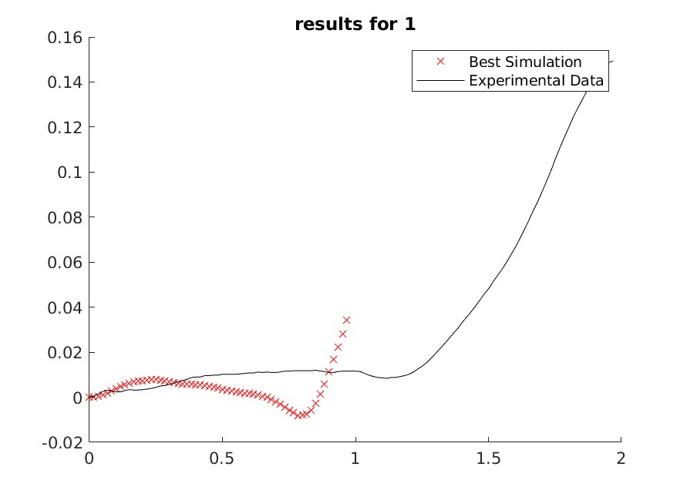
0.5 Hz

Slide 4
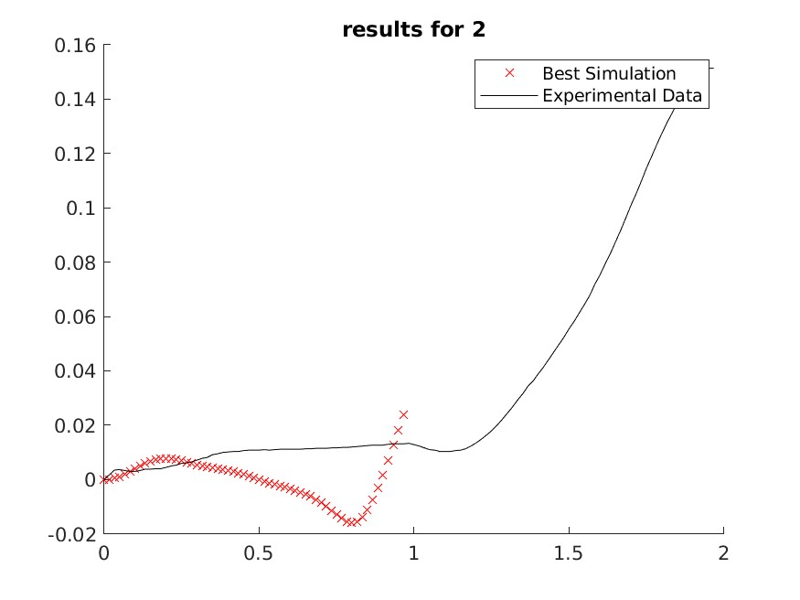
0.5 Hz

Slide 5
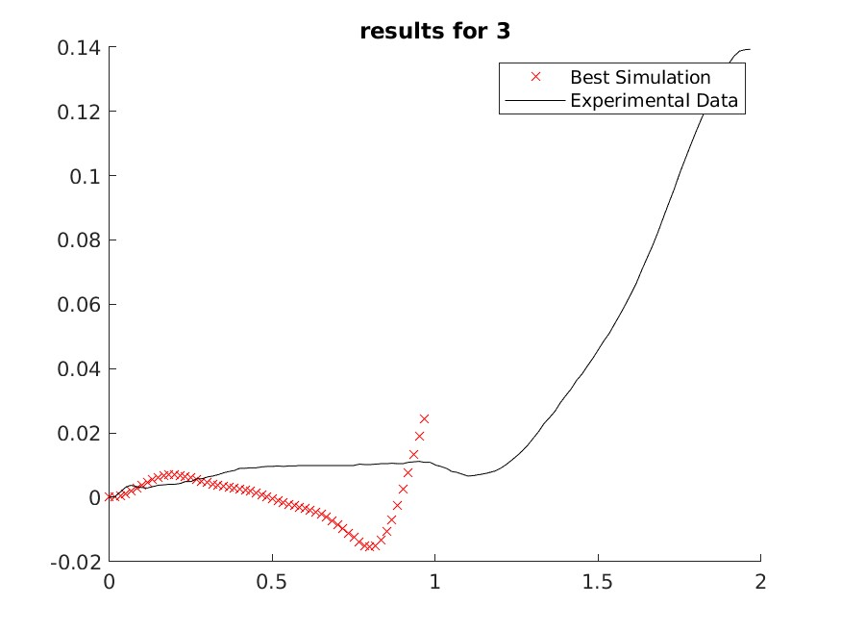
0.5 Hz

Slide 6
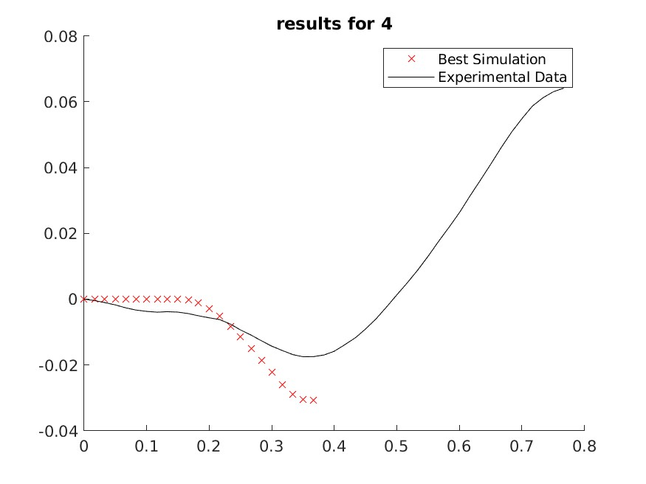
1.25 Hz

Slide 7
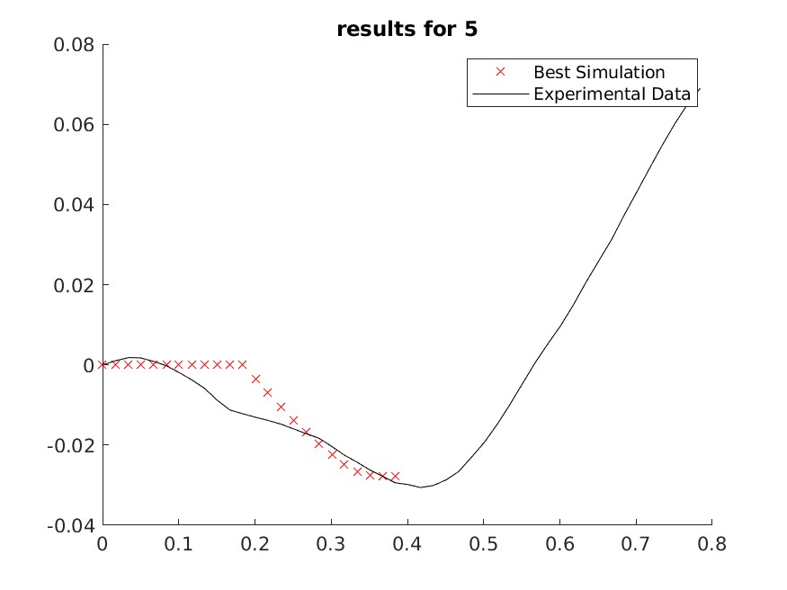
1.25 Hz

Slide 8
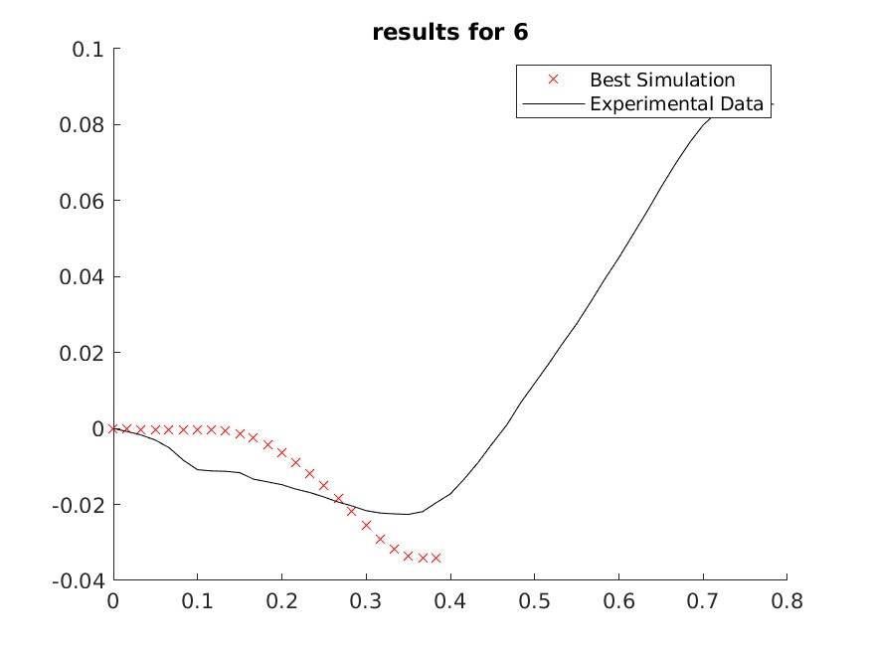
1.25 Hz

Slide 9
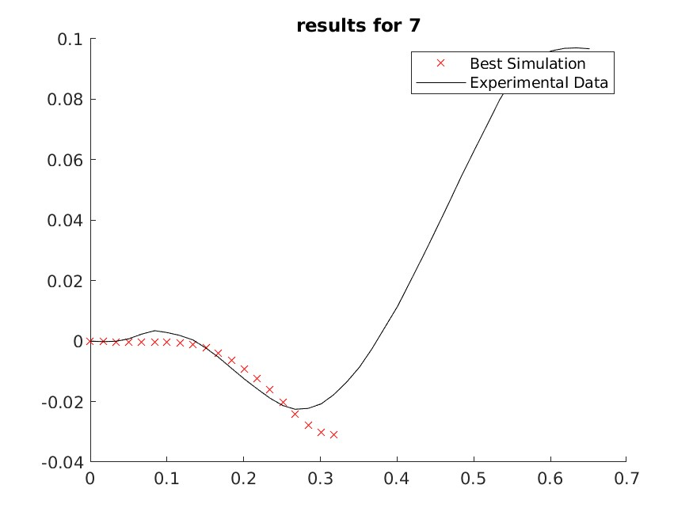
1.5 Hz

Slide 10
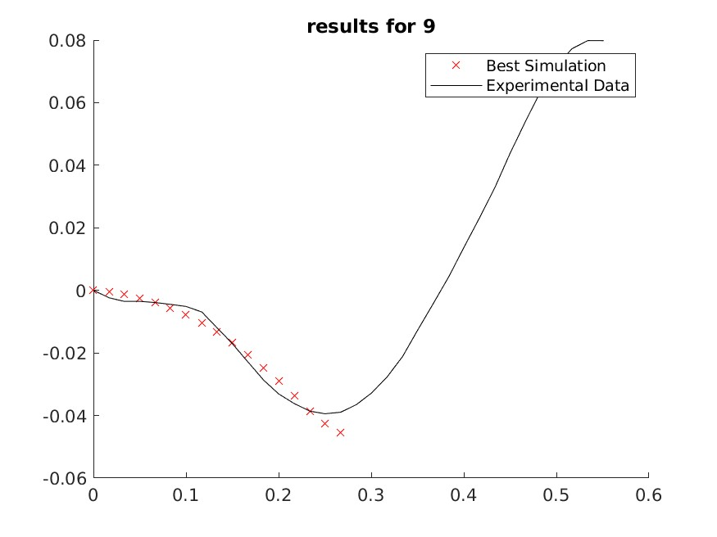
1.75 Hz

Slide 11
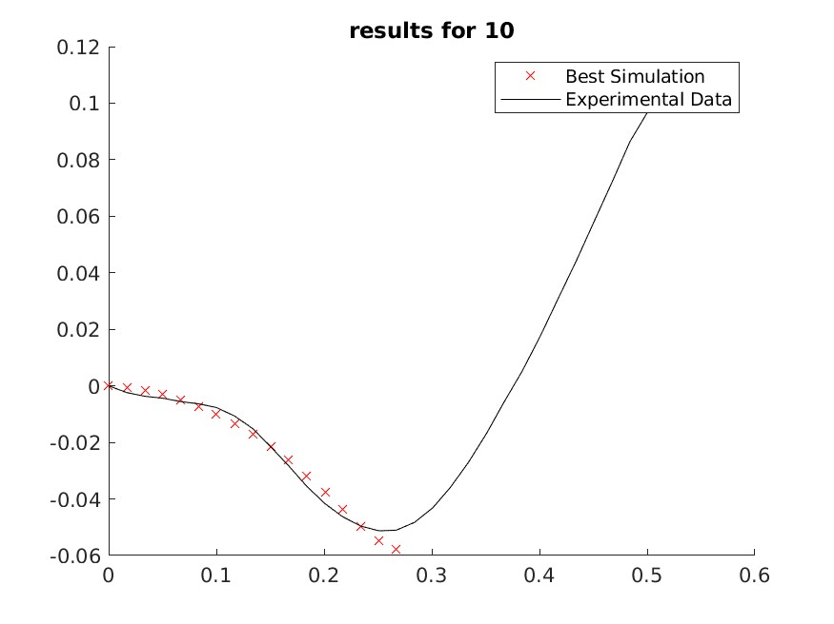
1.75 Hz

Slide 12
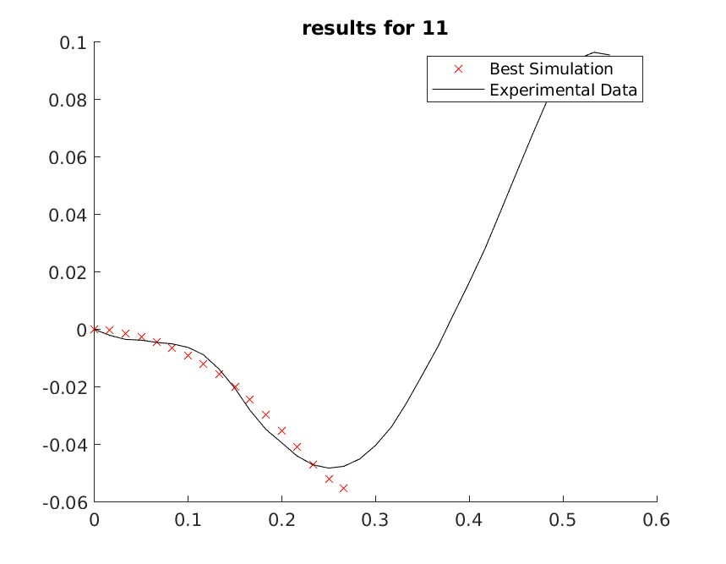
1.75 Hz

Slide 13
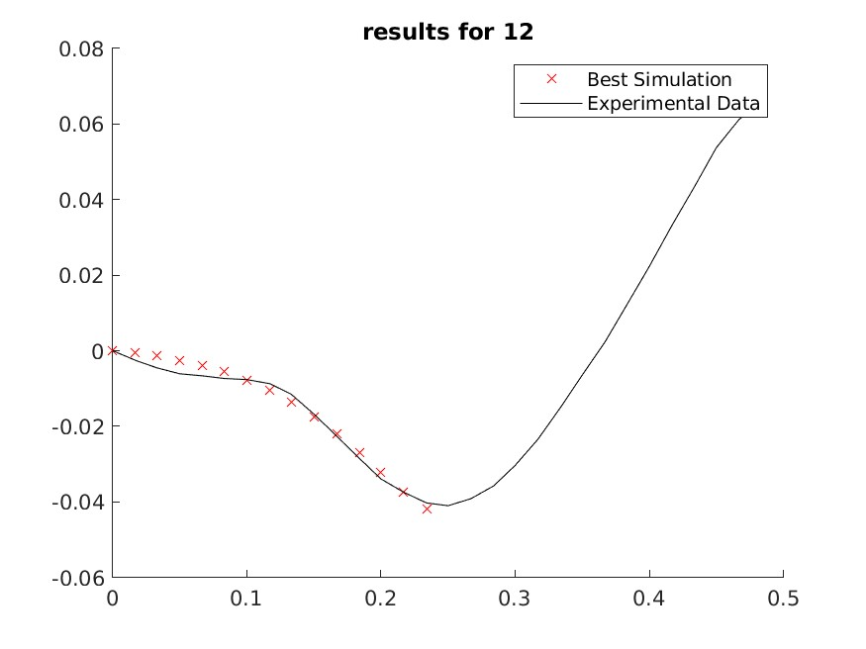
2.0 Hz

Slide 14
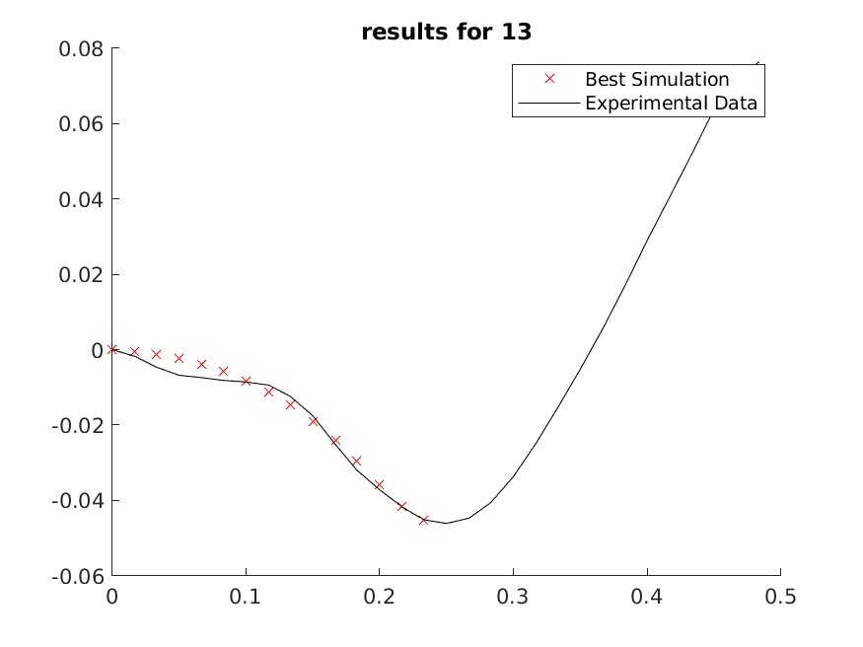
2.0 Hz

Slide 15

2.0 Hz

Slide 16
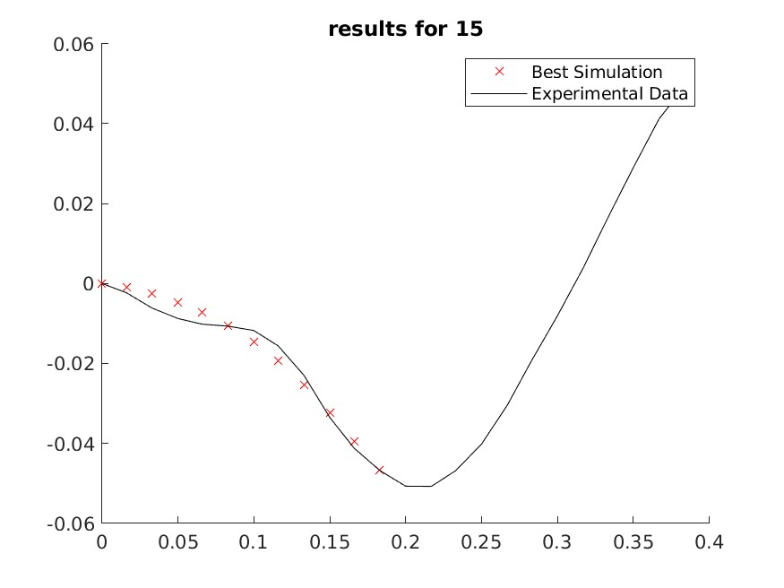
2.5 Hz

Slide 17
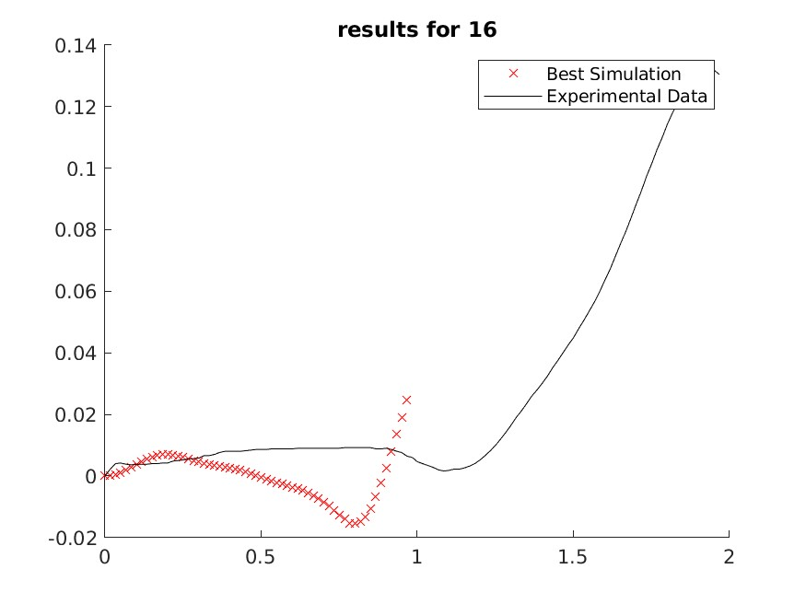
0.5 Hz

Slide 18
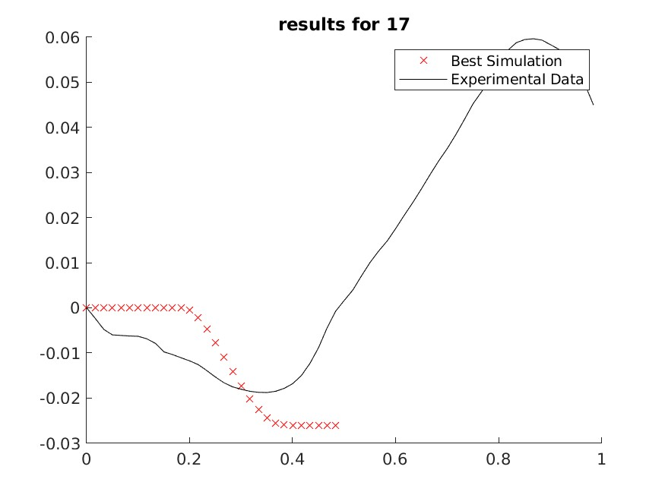
1.0 Hz

Slide 19
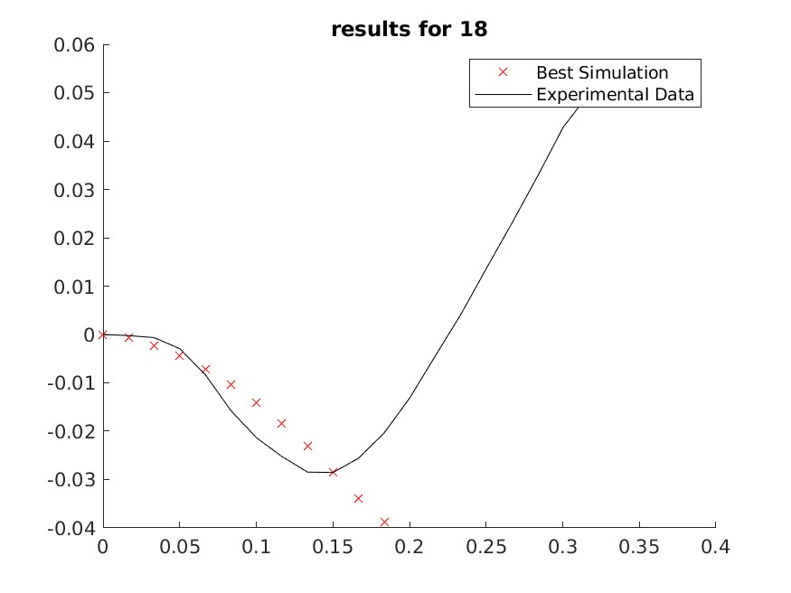
2.5 Hz

